Slide 1
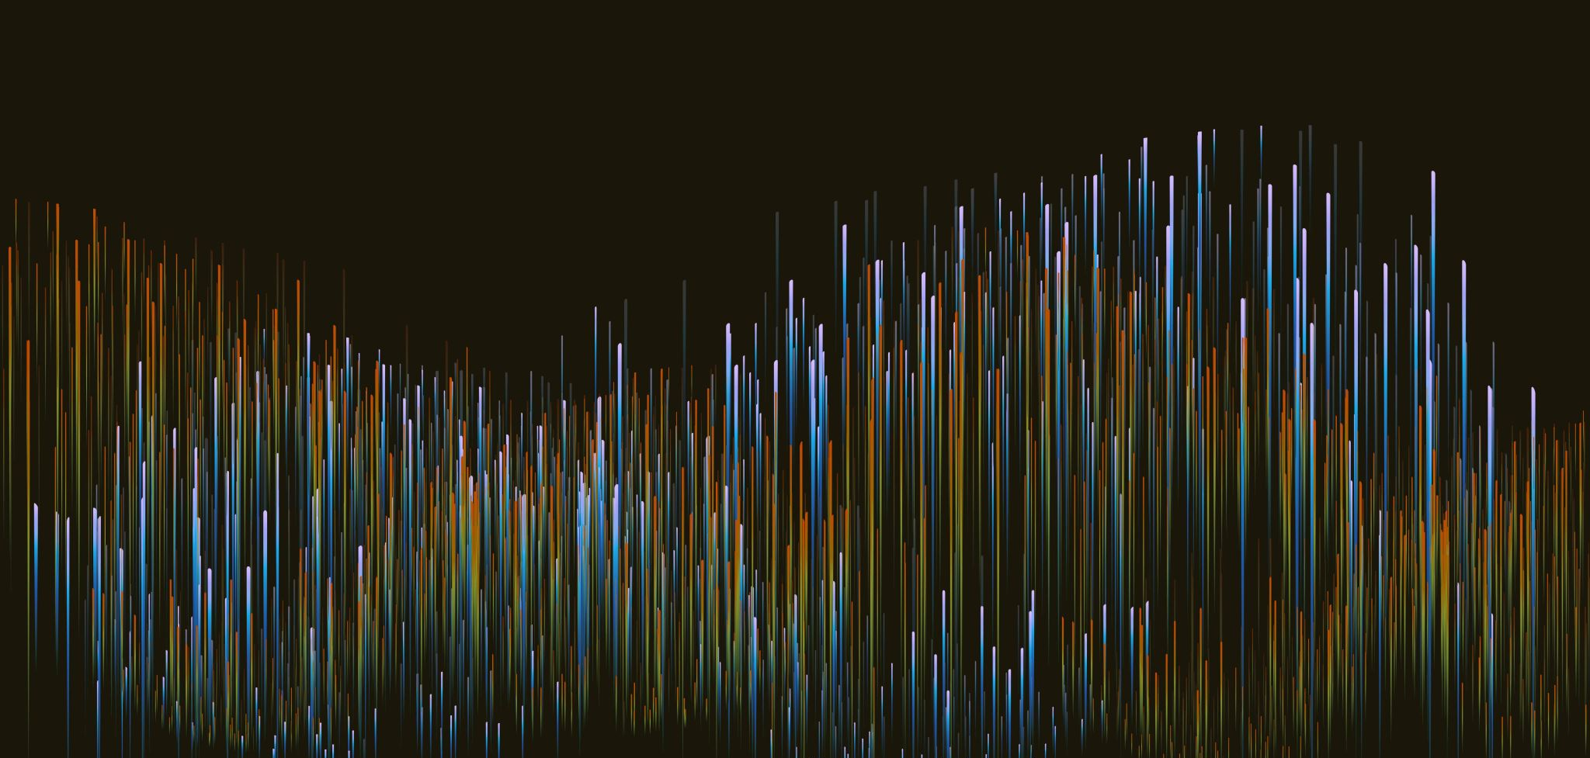
Multi-Agent System Simulation with RePast Simphony
MAS Interaction

Slide 2
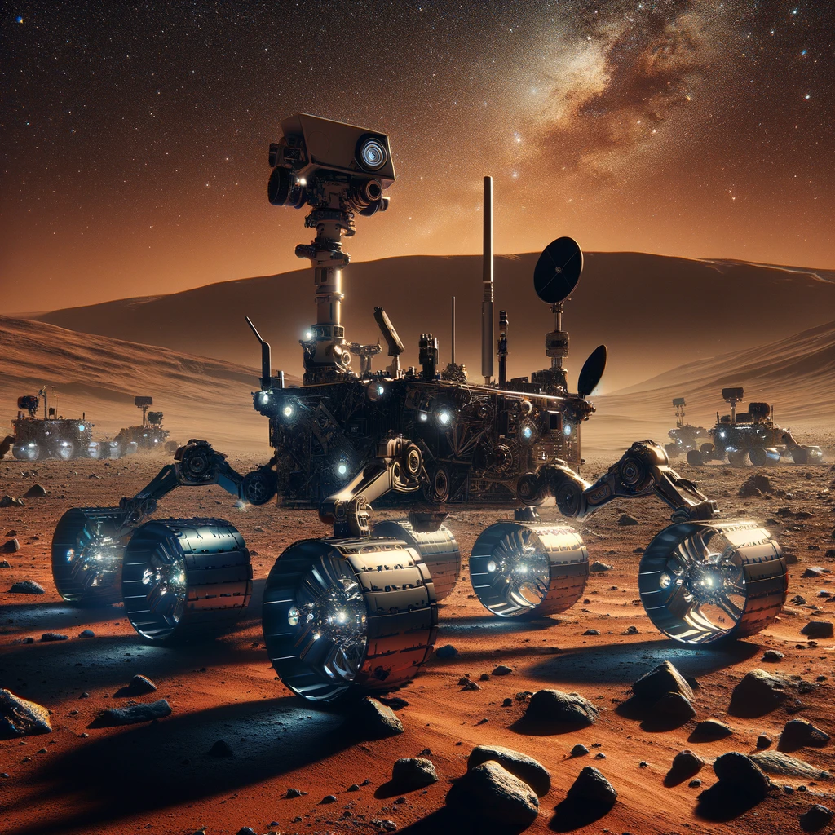
MARS EXPLORERS SIMULATION

Slide 3
